Slide 1
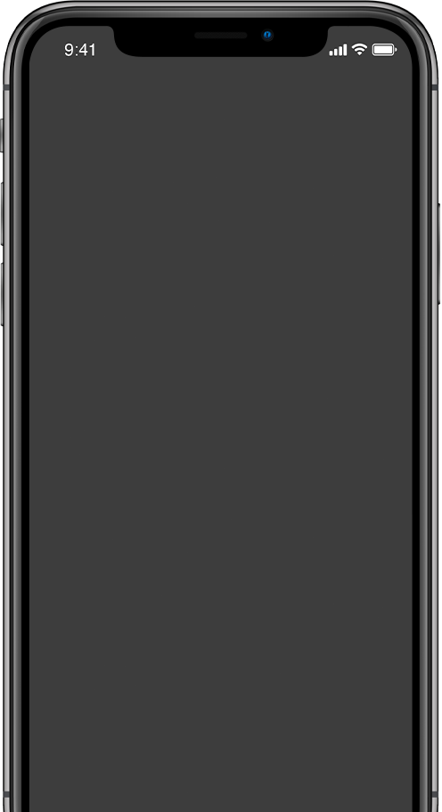

MOBILE TECHNOLOGY
NAME STUDENT ID
- ATUL RAJ TEWARY
- 13856043
SUBJECT CODE - CP5307

Slide 2




OUTLINE
UTILITY APP EDUCATION APP TECHNICAL ASPECTS LIMITATIONS
MOBILE COMPUTING ISSUES

Slide 3
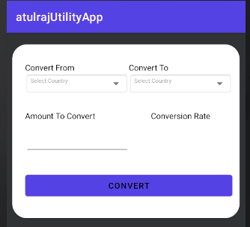
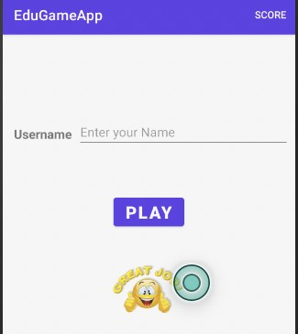


TECHNICAL ASPECTS
SPINNER TEXT VIEW EDIT TEXT API CALL
DIFFERENT LAYOUTS
Utility App(Currency Converter)
Educational Game

Slide 4
SOFTWARE TOOL USED
ANDROID STUDIO

Slide 5

LIMITATIONS
APP NOT WORKING(CRASHED).
TIME BOUND FOR SUBMISSION.
NEW TO APP DEVELOPMENT(CLASS & METHODS).
TIME BOUND FOR SUBMISSION.
ISSUES REGARDING FUNCTIONALITIES
BROWSING INTERNET FOR EXTRA KNOWLEDGE.

Slide 6
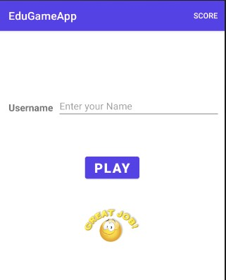
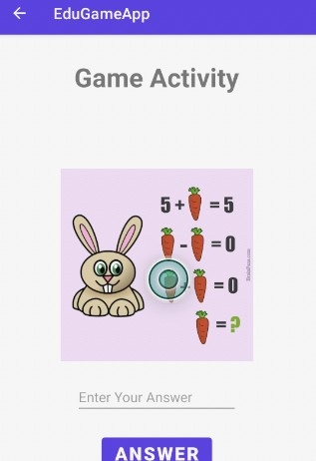
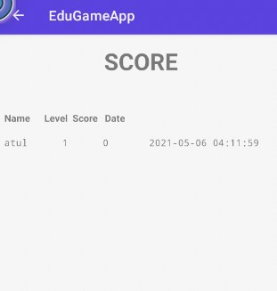
EDUCATION GAME
ASSIGNMENT-2

Slide 7
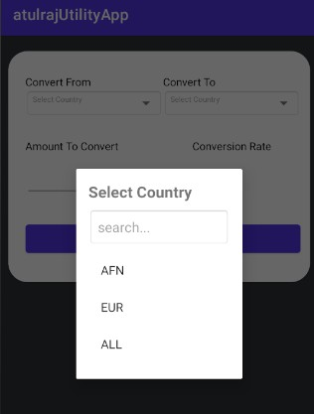
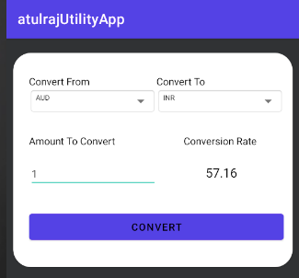
UTILITY APP
ASSIGNMENT-1

Slide 8



MOBILE COMPUTING DISCUSSION
FUTURE MOBILE PROMISE TO BE EVEN FASTER THAN TODAYS MOBILE AND SMALLER THAN DECK OF CARDS.
THE DEMAND FOR APPS IS ACELERATING AND TECHNOLOGY IS EVER-ADVANCING.
MANY MOBILE APP DEVELOPER ALSO HAD PREVIOUS EXPERIENCE IN ROLES SUCH AS WEB DEVELOPER,SOFTWARE ENGINEER ETC.

Slide 9

THANK YOU!
www.reallygreatsite.com
hello@reallygreatsite.com
123-456-7890

